Slide 1
MOD006671
Quantitative Methods for Banking and Finance
Week 3
Measures of Variation

Slide 2
Shape of a Distribution
Describes how data are distributed
Two useful shape related statistics are:
  Skewness
    Measures the extent to which data values are not symmetrical
  Kurtosis
    Kurtosis affects the peakedness of the curve of the distribution—that is, how sharply the curve rises approaching the center of the distribution

Slide 3
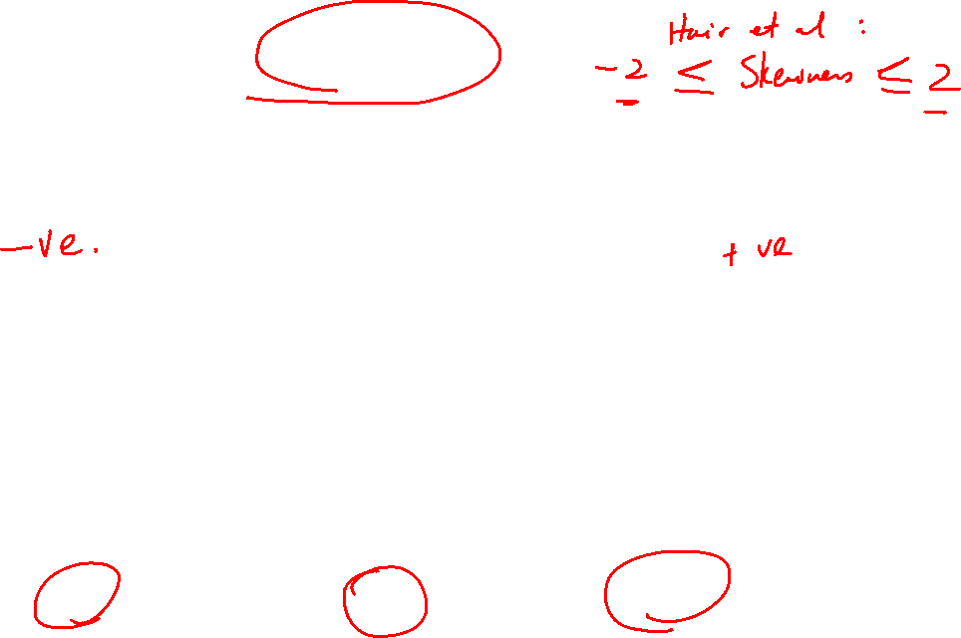
Shape of a Distribution (Skewness)
Measures the extent to which data is not symmetrical
Left-Skewed
Symmetric
Right-Skewed
Mean < Median
Mean = Median
Median < Mean
Skewness
Statistic
< 0 0 >0

Slide 4
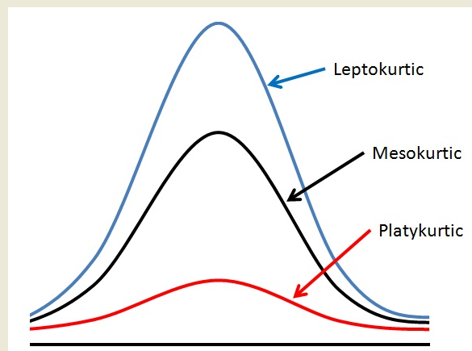
Shape of a Distribution -- Kurtosis measures how sharply the curve rises approaching the center of the distribution)
Kurtosis is a statistical measure used to describe the degree to which data cluster in the tails or the peak of a frequency distribution.
Sharper Peak
Than Bell-Shaped
(Kurtosis > 0)
Bell-Shaped
(Kurtosis = 0)
Flatter Than
Bell-Shaped
(Kurtosis < 0)

Slide 5
Leptokurtic
Has very long and skinny tails, which suggest there are more chances of outliers.
Positive values of kurtosis indicate that distribution is peaked and possesses thick tails.
An extreme positive kurtosis indicates a distribution where more of the numbers are located in the tails of the distribution instead of around the mean.
But the more relevant issue (especially for investors) is there are occasional extreme outliers that cause this "concentration" appearance.

Slide 6
Platykurtic
Has a lower tail and stretched around center tails
This suggest that most of the data points are present in high proximity with mean.
A platykurtic distribution is flatter (less peaked) when compared with the normal distribution.
For investors, platykurtic return distributions are stable and predictable, in the sense that there will rarely (if ever) be extreme (outlier) returns

Slide 7
Mesokurtic
Mesokurtic is the same as the normal distribution,
Which means kurtosis is near to 0.
In Mesokurtic, distributions are moderate in breadth, and curves are a medium peaked height.

Slide 8
Kurtosis Interpretation
In finance, kurtosis is used as a measure of financial risk.
A large kurtosis is associated with a high level of risk for an investment because it indicates that there are high probabilities of extremely large and extremely small returns.
On the other hand, a small kurtosis signals a moderate level of risk because the probabilities of extreme returns are relatively low.
For investors, high kurtosis of the return distribution implies the investor will experience occasional extreme returns (either positive or negative), more extreme than the usual + or - 3 standard deviations from the mean that is predicted by the normal distribution of returns.
This phenomenon is known as kurtosis risk.

Slide 9
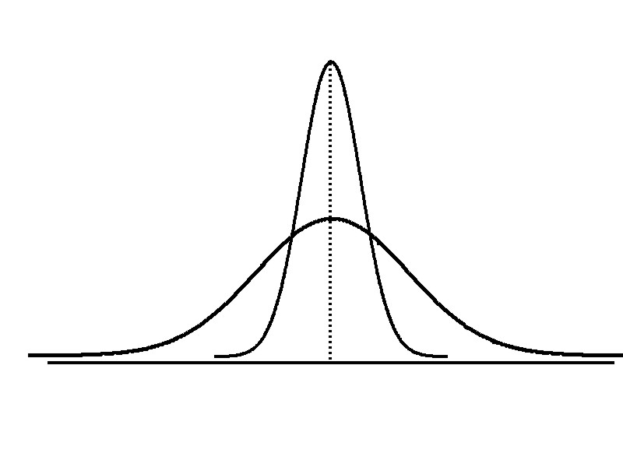
Measures of Variation
Variation
Range
Variance
Standard Deviation
Coefficient of Variation
Measures of variation give information on the spread or variability or dispersion of the data values.
Same center,
different variation

Slide 10

Measures of Variation: The Range
Simplest measure of variation
Difference between the largest and the smallest values:
$$Range= X_{maximum}−X_{minimum}$$
Example:
0 1 2 3 4 5 6 7 8 9 10 11 12 13 14
Range = 13 - 1 = 12

Slide 11
Measures of Variation:
Why The Range Can Be Misleading
Ignores the way in which data are distributed
Sensitive to outliers
7 8 9 10 11 12
7 8 9 10 11 12
Range = 12 - 7 = 5
Range = 12 - 7 = 5
1,1,1,1,1,1,1,1,1,1,1,2,2,2,2,2,2,2,2,3,3,3,3,4,5
Range = 5 - 1 = 4
1,1,1,1,1,1,1,1,1,1,1,2,2,2,2,2,2,2,2,3,3,3,3,4,120
Range = 120 - 1 = 119

Slide 12
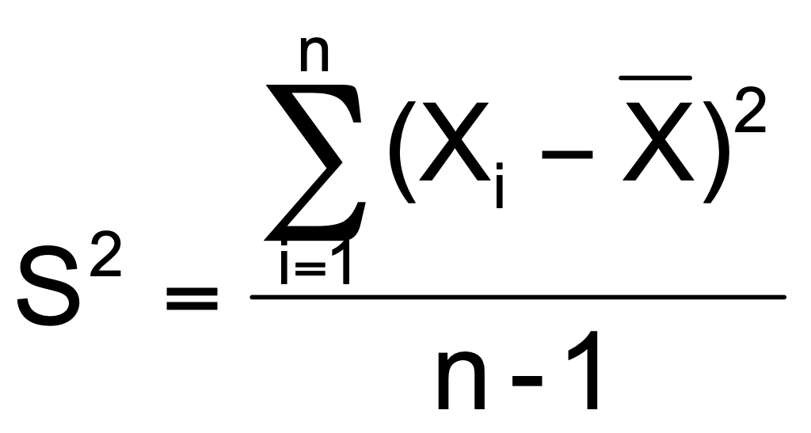
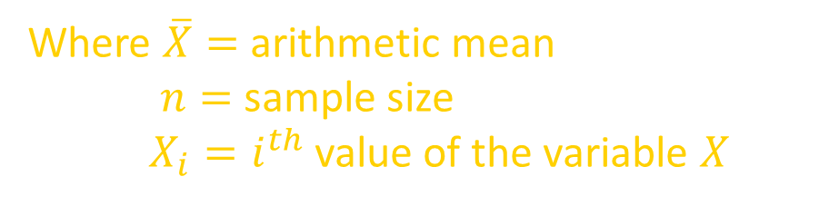
Measures of Variation:
The Sample Variance
Average (approximately) of squared deviations of values from the mean
  Sample variance:
Where $\overline{X}=$ arithmetic mean
$n=$ sample size
$X_{i}=i^{th}$ value of the variable $X$

Slide 13
Interpretation of Sample Variance
If the numbers in a list are all close to the expected values, the variance will be small.
If they are far away, the variance will be large.
A sample variance calculation is at its most powerful when it is used to compare two different sets of data, say genotype frequency distributions in New York City as compared with those in Santa Fe, New Mexico.

Slide 14
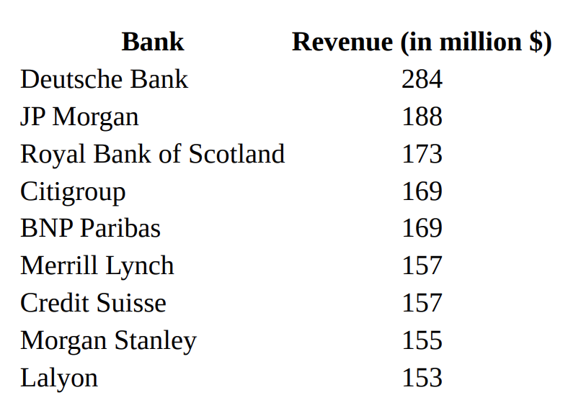
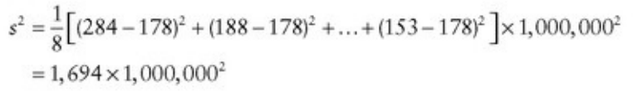
Example: Ranking of European Banks by Investment Banking Revenue from January through March 2007
Source: Dealogic published in the European edition of the Wall Street Journal, March 20, 2007.

Slide 15
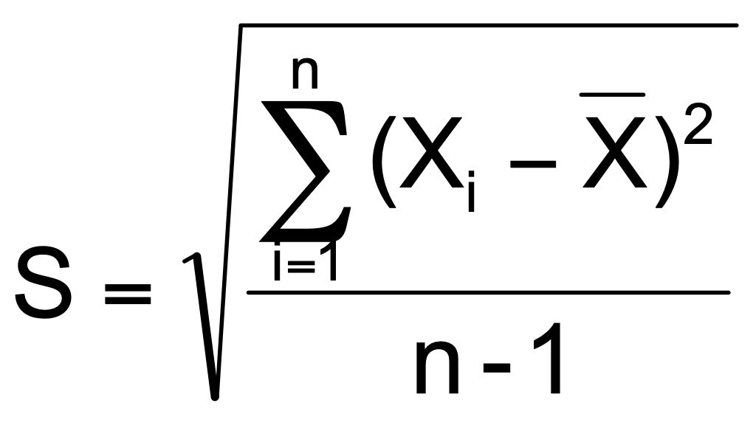
Measures of Variation: The Sample Standard Deviation
Most commonly used measure of variation
Shows variation about the mean
Is the square root of the variance
Has the same units as the original data
  Sample standard deviation:

Slide 16
Interpretation of Standard Deviation
Low standard deviation means data are clustered around the mean
High standard deviation indicates data are more spread out
Standard deviation, in finance, is often used as a measure of a relative riskiness of an asset.
A volatile stock has a high standard deviation, while the deviation of a stable blue-chip stock is usually rather low.
As a downside, the standard deviation calculates all uncertainty as risk, even when it’s in the investor's favor—such as above-average returns.

Slide 17

Example: Ranking of European Banks by Investment Banking Revenue from January through March 2007
Sample standard deviation
Source: Dealogic published in the European edition of the Wall Street Journal, March 20, 2007.

Slide 18
Measures of Variation:
Sample Standard Deviation:
Calculation Example
Sample
Data (X_{i}) : 10 12 14 15 17 18 18 24

Slide 19
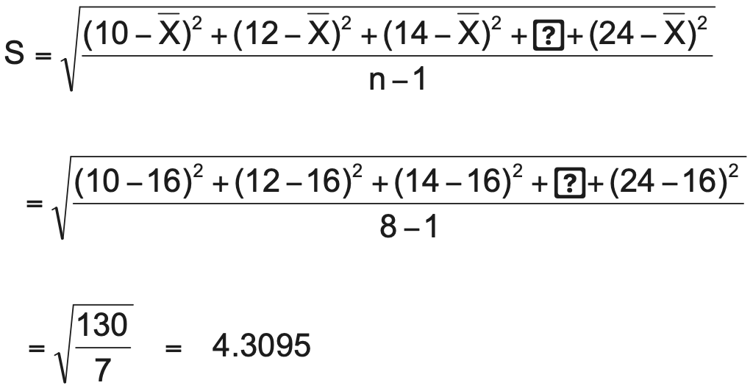
Measures of Variation: Sample Standard Deviation
Calculation Example
Sample
Data (X_{i}) : 10 12 14 15 17 18 18 24
n = 8 Mean = X = 16
A measure of the “average” scatter around the mean
4.3095

Slide 20

Measures of Variation:
Comparing Standard Deviations
Data A
Mean = 15.5
S = 3.338
11 12 13 14 15 16 17 18 19 20 21
Data B
Mean = 15.5
S = 0.926
11 12 13 14 15 16 17 18 19 20 21
Data C
Mean = 15.5
S = 4.567
11 12 13 14 15 16 17 18 19 20 21

Slide 21
Measures of Variation:
Comparing Standard Deviations
Smaller standard deviation
Larger standard deviation

Slide 22
Measures of Variation: Summary Characteristics
The more the data are spread out, the greater the range, variance, and standard deviation.
The more the data are concentrated, the smaller the range, variance, and standard deviation.
If the values are all the same (no variation), all these measures will be zero.
None of these measures are ever negative.

Slide 23
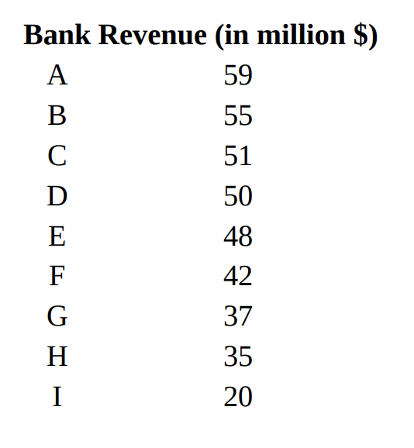
Practice Question 1
x̅= $44 million
S = $12 million
Calculate using Excel:
1. Mean
2. Standard Deviation (S)

Slide 24
Detection of outliers
Quartile & The Interquartile Range
Box plot

Slide 25
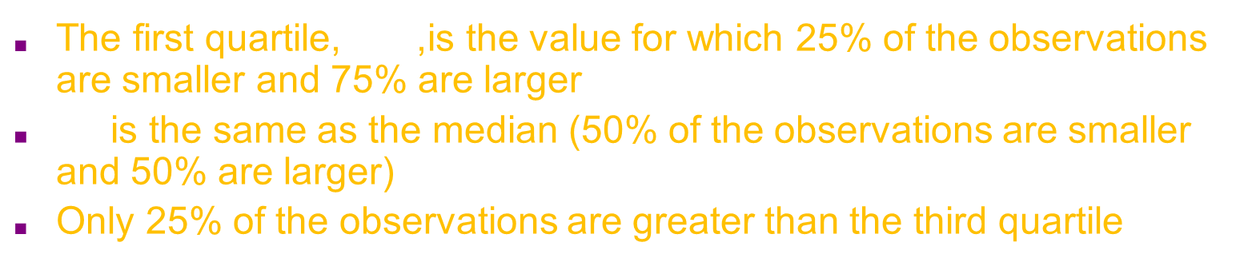
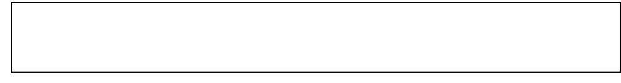



Quartile Measures
$Q_{1}$ and $Q_{3}$ are measures of non-central location
$Q_{2}$ = median, is a measure of central tendency
Quartiles split the ranked data into 4 segments with an equal number of values per segment
25%
25%
25%
25%
$$Q_{1}$$
$$Q_{2}$$
$$Q_{3}$$
The first quartile, $Q_{1}$ , is the value for which 25% of the observations are smaller and 75% are larger
$Q_{2}$ is the same as the median (50% of the observations are smaller and 50% are larger)
Only 25% of the observations are greater than the third quartile

Slide 26
Quartile Measures: Calculation Rules
When calculating the ranked position use the following rules
Put the list of numbers in order
Then cut the list into four equal parts
The Quartiles are at the "cuts"

Slide 27

Quartile Measures: Locating Quartiles
Find a quartile by determining the value in the appropriate position in the ranked data, where
First quartile position: $Q_{1}=\frac{n+1}{4}$ ranked value
Second quartile position: $Q_{2}=\frac{n+1}{2}$ ranked value
Third quartile position: $Q_{3}=\frac{3(n+1)}{4}$ ranked value
where $n$ is the number of observed values
Notes:
Bear in mind, here is to tell you the position in the ranked data, rather the value of quartile.

Slide 28
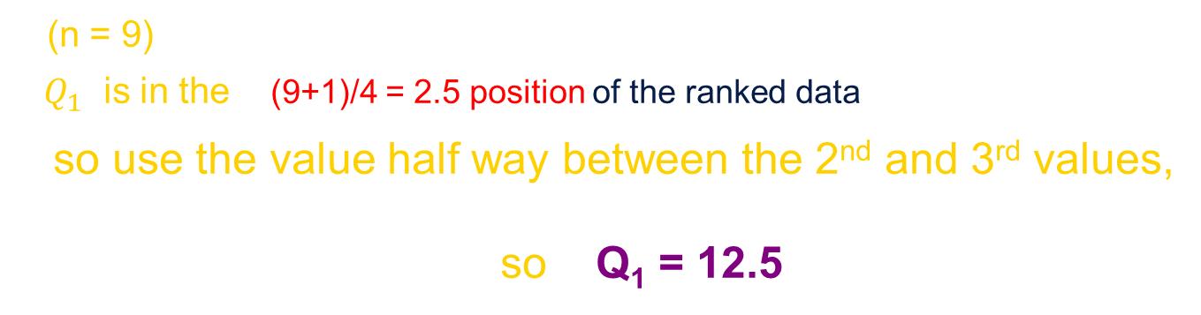
Quartile Measures: Locating Quartiles
Sample Data in Ordered Array: 11 12 13 16 16 17 18 21 22
(n = 9)
$Q_{1}$ is in the (9+1)/4 = 2.5 position of the ranked data
so use the value half way between the 2nd and 3rd values,
so Q₁ = 12.5

Slide 29
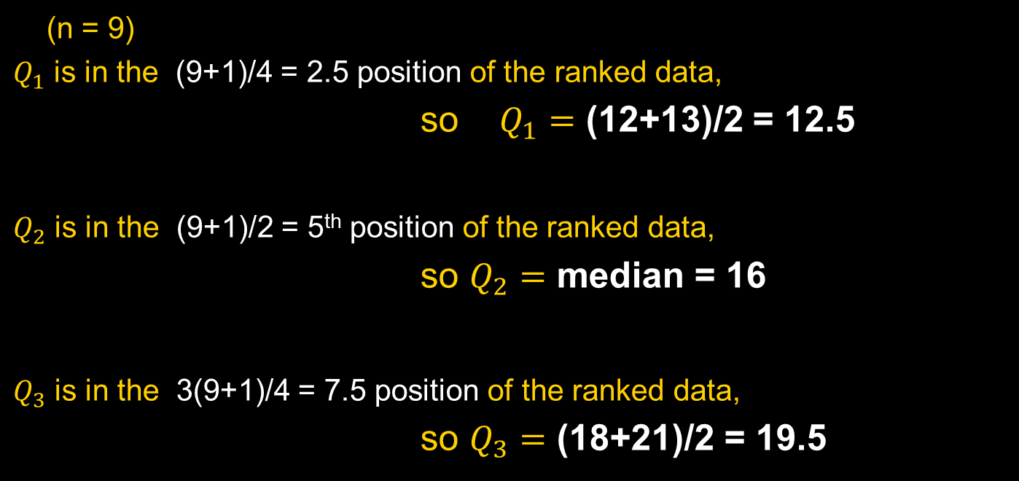
Quartile Measures
Calculating The Quartiles: Example
Sample Data in Ordered Array: 11 12 13 16 16 17 18 21 22
(n = 9)
$Q_{1}$ is in the (9+1)/4 = 2.5 position of the ranked data,
so $Q_{1}=$ (12+13)/2 = 12.5
$Q_{2}$ is in the (9+1)/2 = 5th position of the ranked data,
so $Q_{2}=$ median = 16
$Q_{3}$ is in the 3(9+1)/4 = 7.5 position of the ranked data,
so $Q_{3}=$ (18+21)/2 = 19.5

Slide 30

Quartile Measures: The Interquartile Range (IQR)
The IQR is $Q_{3}−Q_{1}$ and measures the spread in the middle 50% of the data
Hence the IQR is also called the midspread
The IQR is a measure of variability that is not influenced by outliers or extreme values
Measures like $Q_{1}$, $Q_{3}$, and IQR that are not influenced by outliers are called resistant measures

Slide 31


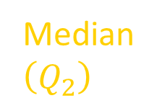


Calculating The Interquartile Range
Example:
Median
$\left(Q_{2}\right)$
$$X_{minimum}$$
$$Q_{1}$$
$$Q_{3}$$
$$X_{maximum}$$
25% 25% 25% 25%
11 12.5 16 19.5 22
Interquartile range
= 19.5 – 12.5 = 7

Slide 32

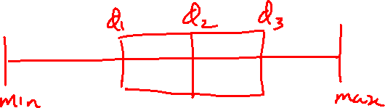
The Five Number Summary
The five numbers that help describe the center, spread and shape of data are:
  $X_{minimum}$
  First Quartile, $Q_{1}$
  Median $Q_{2}$
  Third Quartile, $Q_{3}$
  $X_{maximum}$

Slide 33
Distribution Shape and The Boxplot
Left-Skewed
Symmetric
Right-Skewed
Q₁
Q₂
Q₃
Q₁
Q₂
Q₃
Q₁
Q₂
Q₃
Q₁
Q₂
Q₃
Q₁
Q₂
Q₃

Slide 34
Five Number Summary and
The Boxplot
The Boxplot_ A Graphical display of the data based on the five-number summary:
$$X_{minimum}−Q_{1}−Median−Q_{3}−X_{maximum}$$
Example:
25% of data 25% 25% 25% of data
of data of data
$$X_{minimum} Q_{1} Median Q_{3} X_{maximum}$$

Slide 35

Box plot
Minimum ($Q_{0}$ or 0th percentile): the lowest data point excluding any outliers.
Maximum ($Q_{4}$ or 100th percentile): the largest data point excluding any outliers.
Median ($Q_{2}$ or 50th percentile): the middle value of the dataset.
First quartile ($Q_{1}$ or 25th percentile): also known as the lower quartile $q_{n}(0.25)$, is the median of the lower half of the dataset.
Third quartile ($Q_{3}$ or 75th percentile): also known as the upper quartile $q_{n}(0.75)$, is the median of the upper half of the dataset.^{[4]}

Slide 36
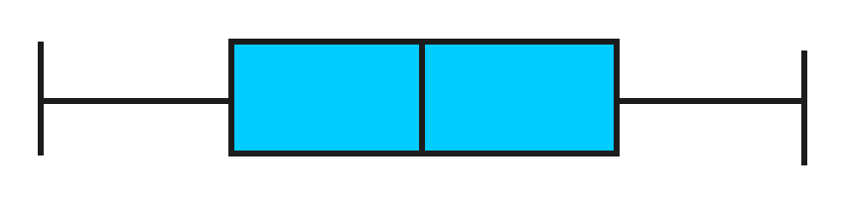
Five Number Summary:
Shape of Boxplots
If data are symmetric around the median then the box and central line are centered between the endpoints
A Boxplot can be shown in either a vertical or horizontal orientation
$X_{minimum} Q_{1} Median Q_{3} X_{maximum}$

Slide 37
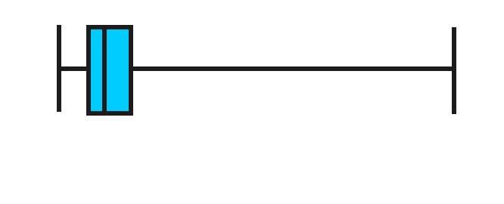
Boxplot Example
Below is a Boxplot for the following data:
0 2 2 2 3 3 4 5 5 9 27
The data are right skewed, as the plot depicts
$$X_{minimum} Q_{1} Q_{2}/Median Q_{3} X_{maximum}$$

Slide 38
Download SPSS
To download SPSS software programme on your laptops or desktops at home, follow the link below:
https://web.anglia.ac.uk/it/students/software/spss/
Please download before next lecture!

